Slide 1



ARTEMIS HACKATHON 2026
TITLE PAGE
Problem Statement No –
Problem Statement Title- Advance gas detection system
PS Category- Hardware
Team Name -

Slide 2
PROBLEM STATEMENT
Problem:
Gas leaks (CO, LPG, CH₄, H₂S) cause fires, explosions, poisoning, and pollution.
Who is Affected:
Industries, homes, hospitals, and environmental agencies.
Challenges:
Low accuracy, false alarms, slow detection, no real-time alerts.
Real-World Relevance:
Prevents disasters, improves safety, enables smart IoT monitoring.

Slide 3
PROPOSED SOLUTION
(YOUR IDEA)
Concept
Smart system that detects hazardous gases and prevents accidents through early warning.
Working
Sensors detect gas → Controller analyses levels → Alarm/notification triggers → Safety system activates.
Key Features
• Multi-gas detection
• Real-time monitoring
• Remote alerts

Slide 4
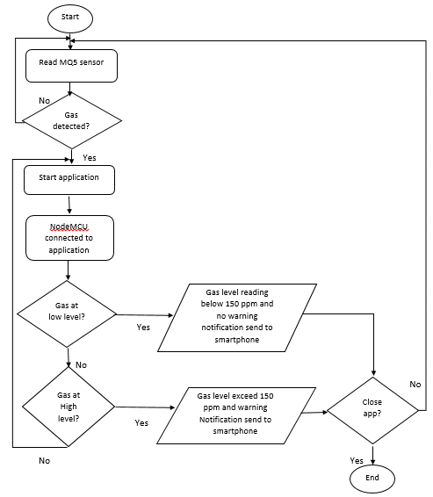
TECHNICAL APPROACH
Technologies to be used Python for dashboard, Hardware GSM,GPS Module , ESP32 Microcontroller , buzzer , led , wires , breadboard

Slide 5
FEASIBILITY AND VIABILITY
Feasibility:
Integration of NDIR, electrochemical, and MOS sensors for multi-gas detection.
Real-time data acquisition via ESP32/ARM MCU with IoT (LoRa/GSM/Wi-Fi).
Edge processing for threshold analysis and anomaly detection.
Scalable architecture for industrial and confined-space monitoring.
Challenges:
Sensor drift, cross-sensitivity, environmental interference, network failure.
Mitigation:
Auto-calibration, sensor fusion, environmental compensation, redundant power & communication.

Slide 6
CHALLENGES & RISKS
Sensor Drift & Aging: Gradual loss of sensitivity leading to inaccurate gas concentration readings.
Cross-Sensitivity: Interference from non-target gases causing false alarms.
Environmental Variations: Temperature, humidity, and pressure affecting sensor performance.
Calibration Dependency: Frequent calibration required to maintain accuracy.
Power & Network Failure: Risk of system downtime and delayed alerts.
Explosion Hazard: Electronic components may pose ignition risk in flammable environments.
Data Security Risks: Vulnerability in IoT-based remote monitoring systems.

Slide 7
IMPACT AND BENEFITS
Potential Impact
Enhances safety for workers and residents
Reduces industrial accidents and gas leaks
Supports quick emergency response
Helps monitor environmental pollution
Benefits
Social: Saves lives, improves safety awareness
Economic: Reduces losses, downtime, and insurance costs
Environmental: Controls toxic emissions, protects air quality

Slide 8
TARGET USERS
Industrial Facilities – Oil & gas plants, chemical factories, refineries
Commercial Buildings – Malls, hospitals, hotels, IT parks
Residential Apartments – Smart homes & gated communities
Fire & Safety Departments – Early hazard detection and prevention
Transportation & Storage Units – Gas storage tanks, pipelines, LPG carriers
Petroleum & Energy Sector – Leak monitoring & explosion prevention

Slide 9
FUTURE SCOPE
AI-Based Predictive Leak Detection – Early warning before critical failure
IoT Integration – Real-time remote monitoring via cloud & mobile apps
Smart City Integration – City-wide environmental gas monitoring
Drone-Based Gas Surveillance – Monitoring hazardous & remote areas
Machine Learning Analytics – Pattern recognition for risk prediction

Slide 10
BUSINESS MODEL / PROFIT STRATEGY
Revenue Streams:
Hardware Sales – Gas detection devices & sensors
Subscription Model – Cloud monitoring & data analytics (monthly/yearly)
Installation & Maintenance Services – AMC contracts
Premium AI Analytics – Predictive safety insights
Profit Strategy:
Recurring revenue through subscription & AMC
Target high-risk industries (oil & gas, chemical plants)
Government & smart city tenders
Mobile app upgrades & feature-based pricing

Slide 11
RESEARCH AND REFERENCES
Oil Industry Safety Directorate. (2024). Guidelines for Onsite Incident Reporting and Investigation. Ministry of Petroleum & Natural Gas, Government of India. Retrieved from https://www.oisd.gov.in
Defacto Law. (2023). Hazardous Substance Regulation in India. Retrieved from https://www.defactolaw.in
Indian Oil–Adani Gas Pvt. Ltd. (2023). What to do if you smell natural gas. Retrieved from https://ioagpl.com
Indraprastha Gas Limited. (2023). Safety Tips. Retrieved from https://www.iglonline.net
The Better India. (2023). Suspect a LPG leak? 8 steps that can ensure your safety! Retrieved from https://thebetterindia.com
International Journal of Innovative Science and Advanced Engineering (IJISAE). (2022). Smart Gas Leakage Detector Using IoT Sensors. Retrieved from https://ijisae.org
International Journal of Engineering Research & Technology (IJERT). (2022). Smart Industrial Level Gas Leakage Detection System Using AI and IoT. Retrieved from https://www.ijert.org
GasSafe India Limited. (2023). Gas Safety Devices for Domestic and Industrial Use. Retrieved from https://gassafe.net.in
Indian Oil Corporation Limited. (2024). Health and Safety. Retrieved from https://cx.indianoilcgd.com

Slide 12

IMPORTANT INSTRUCTIONS
Please ensure below pointers are met while submitting the Idea PPT:
Try to avoid paragraphs and post your idea in points /diagrams / Infographics /pictures
Keep your explanation precise and easy to understand
You can only use provided template for making the PPT without changing the idea details pointers (mentioned in previous slides).
Note - You can delete this slide (Important Pointers) when you give the seminar.

